Slide 1
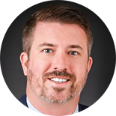




Staff Well-Being and Resilience in Correctional Environments- During and After a Pandemic
Robin Belcher-Timme, Psy.D, ABPP, CCHP-HM Vice President & Senior Consultant Falcon Inc., USA | Dr Gabriel Ong Principal Psychologist & Deputy Director of PCRD Singapore Prison Service | Dr Sarah Lewis Director Penal Reform Solutions United Kingdom | Dr Jake Phillips Reader in Criminology Sheffield Hallam University United Kingdom
Introduction: Dr Frank Porporino, IACFP President, Chair of ICPA Research & Development Network Group
Facilitated by Cherie Townsend, Executive Director IACFP

Slide 2
DR FRANK PORPORINO
IACFP PRESIDENT

Slide 3

What to Expect…
“Speaker View”
Panelists will each present information
Polling
“Chat” will be used throughout the webinar. Use it to ask questions; the facilitator will then organize the questions for the panelists during the last 15 minutes of the webinar
Questions that can’t be answered during the webinar will be answered after it and disseminated to participants

Slide 4
In a few words, please tell us what you hope to get out of this webinar.
Please write your answer in the “chat” box. Thank you!!

Slide 5

Polling Question
How would you rate your current level of stress?
Very high
Elevated and starting to worry me
High but manageable
low

Slide 6
Living With The Pandemic
Robin Timme, Psy.D., ABPP
Senior Expert | Eastern Region Vice President
Falcon Correctional and Community Services, Inc.

Slide 7

Welcome
Pandemic Stress
Collective Trauma
  Loss
  Grief
  Anger
  Confusion
Allow yourself to normalize
Attend to the experience

Slide 8
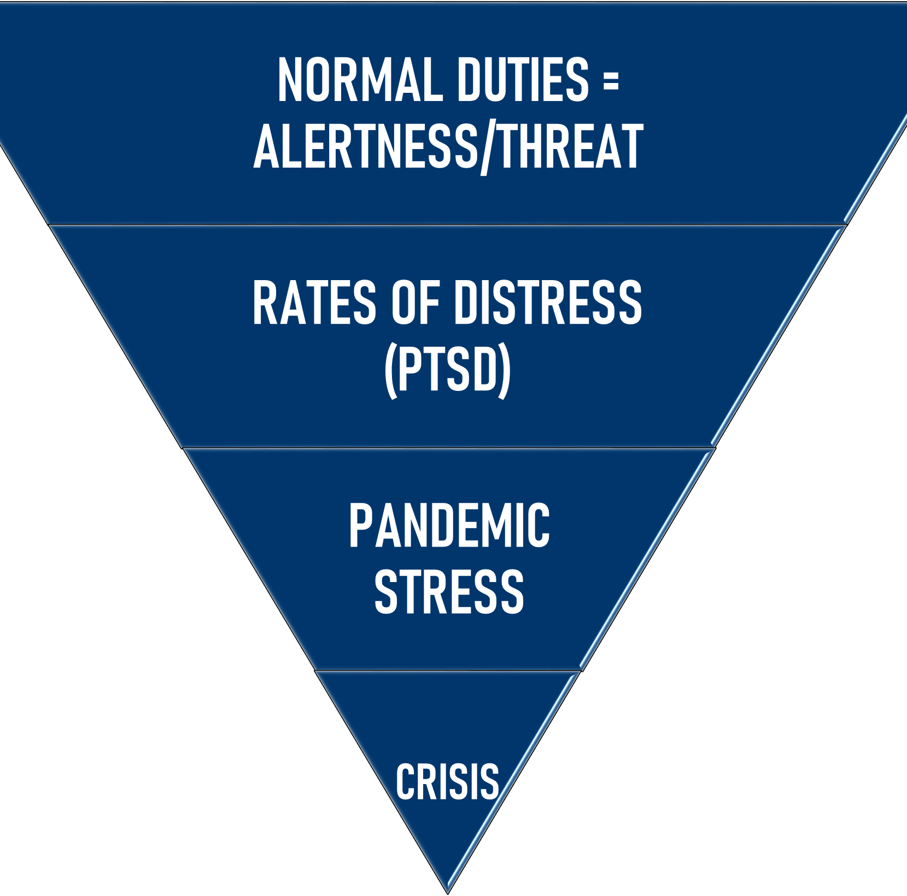
Cumulative Effects of Toxic Stress
For those working in corrections
Layered impact of trauma
Baselines are individualized
Heightened risk
Correctional staff particularly vulnerable to impacts
  High-risk population
  Sickness and death
  Moral injury

Slide 9
Building Resilience
Pre-pandemic functioning
Normalize and unite
Promote confidence and feelings of effectiveness
Establish and maintain routines
Practice pause
Be vigilant for signs of colleagues in distress: signage
Provide regular, reliable, fact-based updates
Limit media exposure

Slide 10
Building Resilience
Culture of peer and supervisory support
Trauma disclosure remains voluntary
Ongoing focus on mental wellness beyond this pandemic
Sleep, diet, exercise
Mindful meals together
Intentional breathing, calming music, gaps as buffers

Slide 11

Polling Question
After receiving some information and participating in the exercise, my level of stress feels like...
It increased
It is the same
It has gone down

Slide 12

Supporting Staff Mental Well-Being and Resilience during COVID-19:
The Singapore Prisons
Experience

Slide 13

As of 5 July 2020
Population = 5.7 million
Total cases = 44,983
Prevalence rate = 0.79%
Graphic from Free Vector Maps

Slide 14
As of 5 July 2020
Total deaths = 26
Population = 5.7 million
Total cases = 44,800
Prevalence rate = 0.78%
Graphic from Free Vector Maps

Slide 15
As of 5 July 2020
COVID-19 in Prisons:
4 newly admitted inmates
1 staff nurse
Graphic from Free Vector Maps

Slide 16
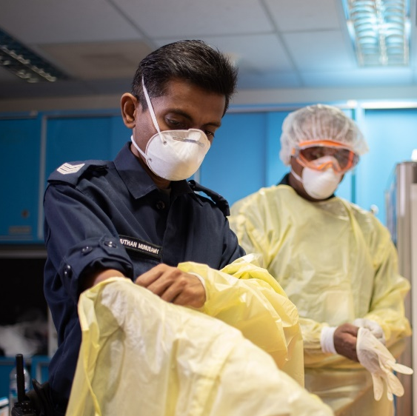
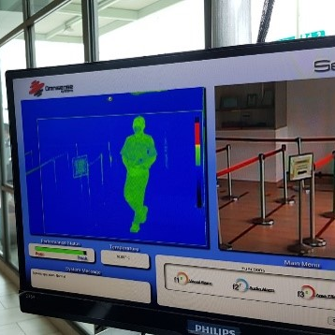
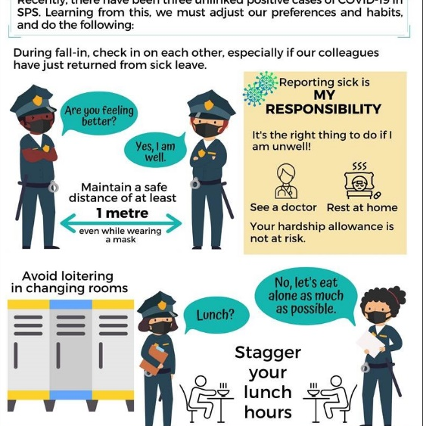
Key Measures to Minimise Risk of
COVID-19 Transmission in Prisons
Prevention
Detection & Isolation
Maintaining
Social
Responsibility

Slide 17

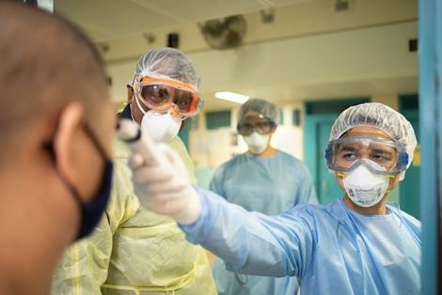
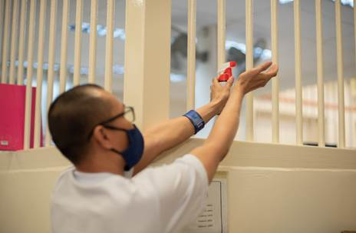
Prevention
Scaling down of non-essential activities
Wearing of masks
Wearing of Personal Protective Equipment (PPE)
Working in split shifts
Cleaning and disinfection of vehicles and workspaces

Slide 18

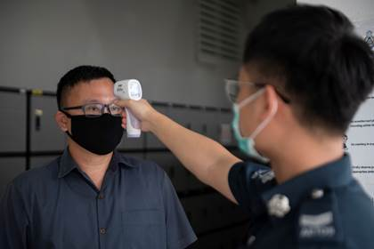
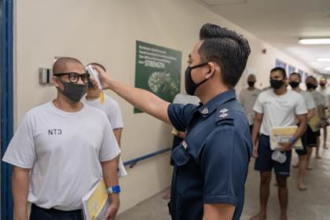
Detection and Isolation
Entry control to premises and compulsory temperature screening and travel/health declarations
Close monitoring of staff and inmate health and well-being
Segregation of newly-admitted inmates in cohorts for 14 days

Slide 19

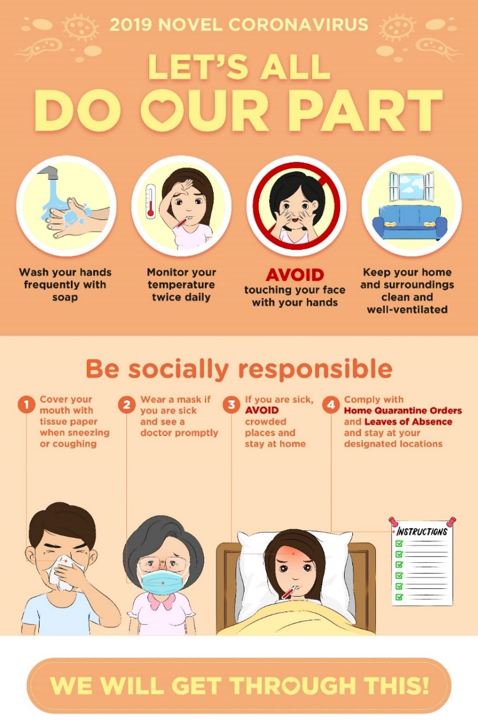
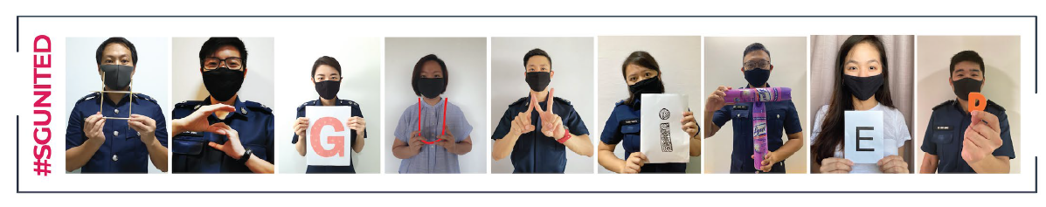
Managing Social Responsibility
Personal hygiene reminders
Enforcement of safe distancing measures
Adoption of telecommuting as default mode of working

Slide 20

Key Strategies to Support Staff Mental Well-Being
Physical
Well-being
Mental
Well-being
Notes:
As we all know, COVID-19 clearly affects our physical and mental well-being. Those in frontline roles are exposed to great risk and can be more susceptible to negative mental health outcomes. Also, the changing demands of work (e.g., working from home, juggling multiple roles at home) can be destabilising.
To help SPS staff, we adopted a three-pronged approach, geared towards strengthening staff’s psychological well-being through the individual, institutional, and organisational levels [CLICK]. These should ideally build upon current resources that staff have [CLICK].

Slide 21
Key Strategies to Support Staff Mental Well-Being
Individual
Institutional
Organisational
Baseline Resilience
Existing Social Support
Notes:
As we all know, COVID-19 clearly affects our physical and mental well-being. Those in frontline roles are exposed to great risk and can be more susceptible to negative mental health outcomes. Also, the changing demands of work (e.g., working from home, juggling multiple roles at home) can be destabilising.
To help SPS staff, we adopted a three-pronged approach, geared towards strengthening staff’s psychological well-being through the individual, institutional, and organisational levels [CLICK]. These should ideally build upon current resources that staff have [CLICK].

Slide 22


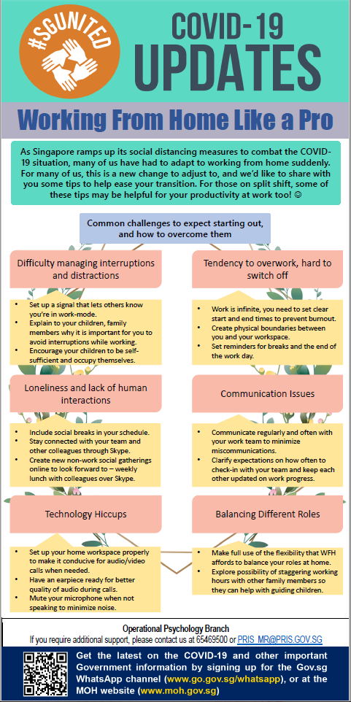
Building Individual PsyCap

Slide 23




Building Individual PsyCap
Notes:
We also developed various guides for staff, and these will be made available for download later. These guides correspond with various stages of the COVID-19 pandemic, from learning how to survive and manage it (in the earlier stages) [CLICK], to building our own inner HEROes (as we progress over time) [CLICK], and thriving in the present (as the nation and world navigates a new normal situation [CLICK].

Slide 24

Providing Institutional Psych Support
Counsellors assigned to every prison institution
  Connecting with institution leadership and providing tailored psychological support interventions
  Monitoring and supporting staff psychological well-being (e.g., providing Psychological First Aid)
Notes:
For leaders, we created a guide which acknowledged the unique stressors they would face as well as how they can enhance hope, efficacy, resilience, and optimism in their staff through effective leadership behaviours [CLICK].

Slide 25


Contributing Psych Perspectives to the Organisation
Notes:
We created a Wall of Appreciation, and online platform where positive messages were collected from staff to staff. These messages were compiled and disseminated via staff broadcasts, videos, and posters around the workplace [CLICK]

Slide 26
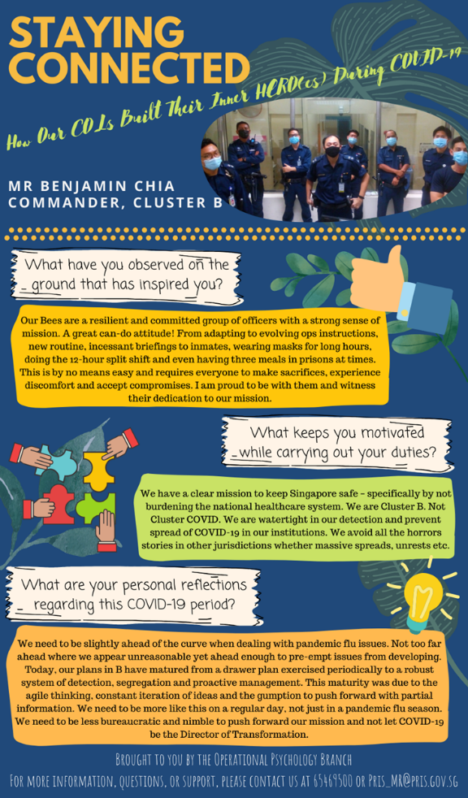
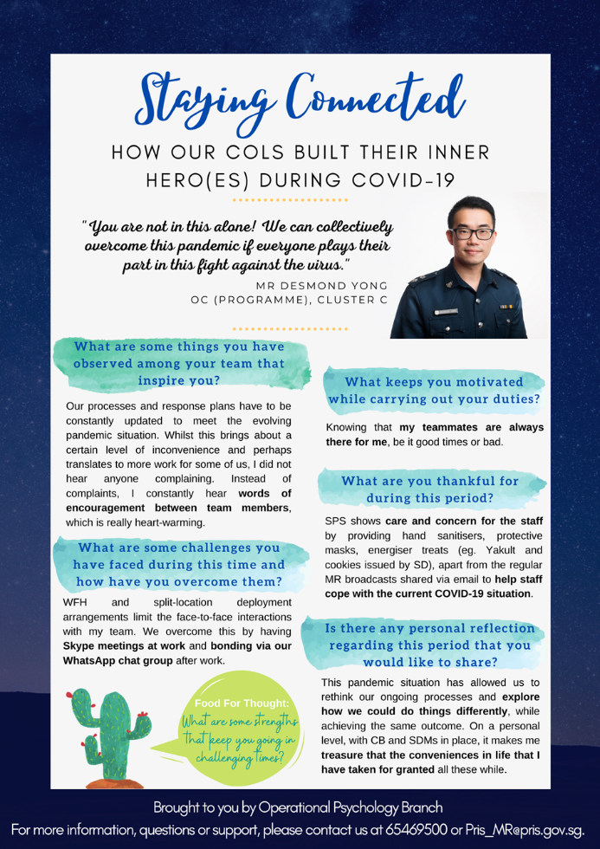
Contributing Psych Perspectives to the Organisation
Notes:
We also used the concept of psychological capital a lot in our products. This was shown earlier in our HERO guides for staff and leaders. Over here, we tried to foster positivity and hope within SPS showing how staff have built their inner HERO during these times. [CLICK]. While doing so, we collaborated closely with our Corporate Comms, HR, and Ops Divisions.

Slide 27
Learning Points
COVID-19 a game-changer – No turning back
Operational measures key to develop staff confidence and assurance to inmates
Mental health strategies help sustain mental well-being and resilience in a prolonged crisis
As COVID-19 evolves, our approach will evolve as well

Slide 28

Resource Sharing
Scan this QR Code or enter this link in your browser to access the resources we have developed
  https://tinyurl.com/yabd4ggq

Slide 29
Thank You
Gabriel_ONG@pris.gov.sg

Slide 30
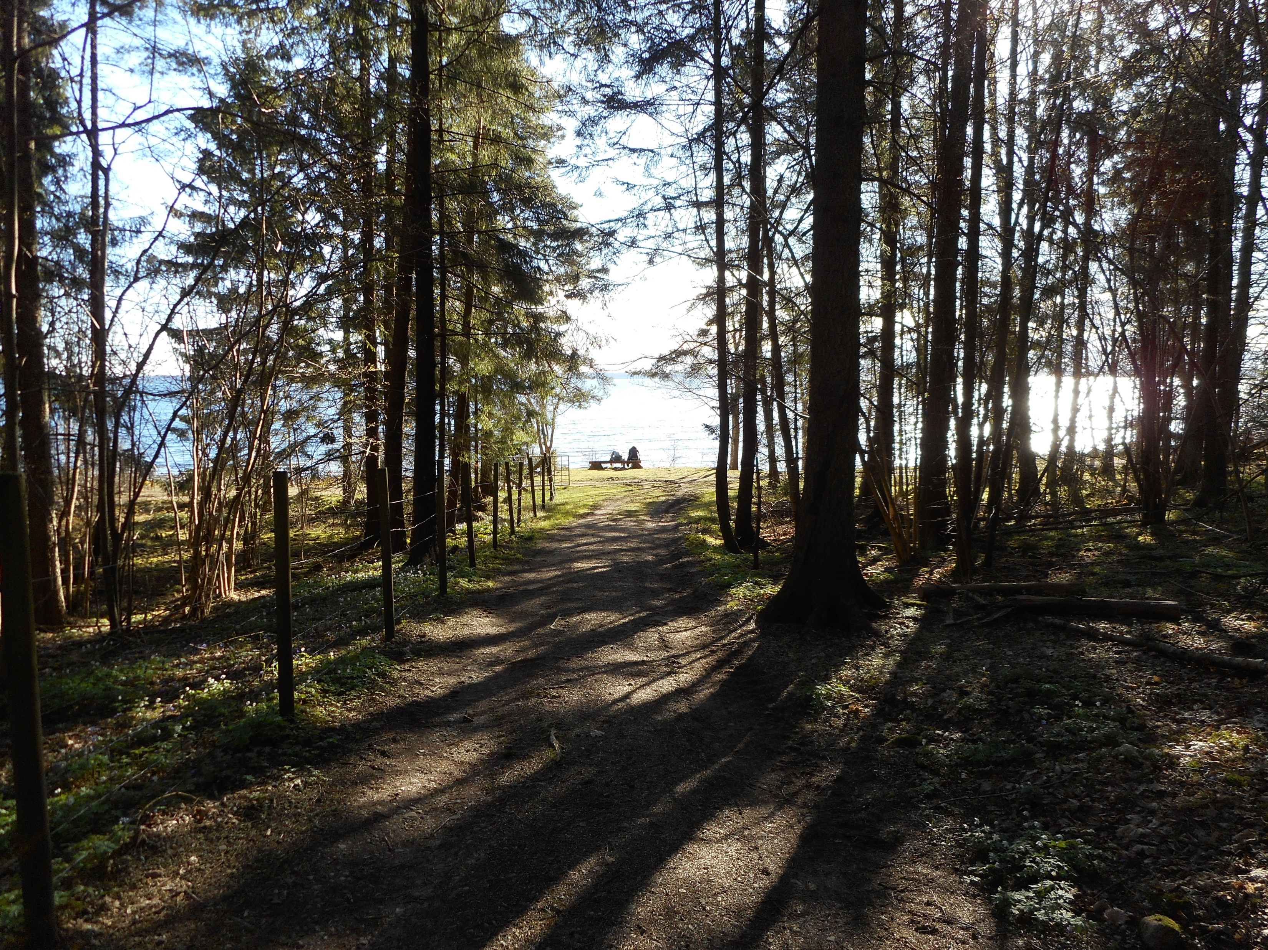

Context Matters

Slide 31
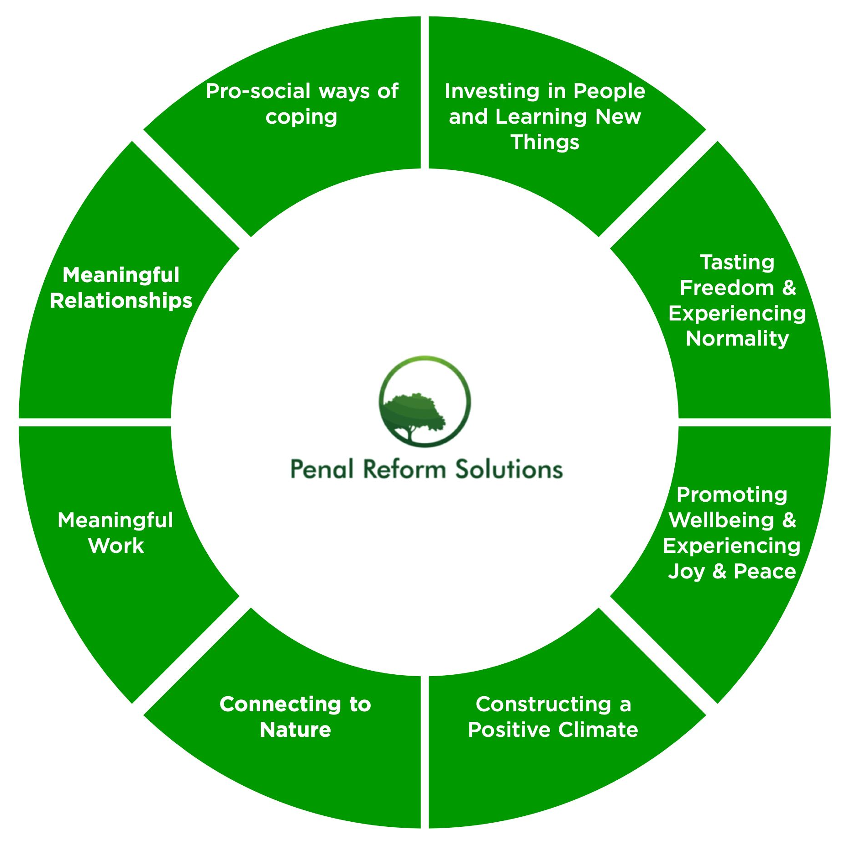
Growth Matters
Proactive Resilience
Post Traumatic Growth
Learning through Loss

Slide 32
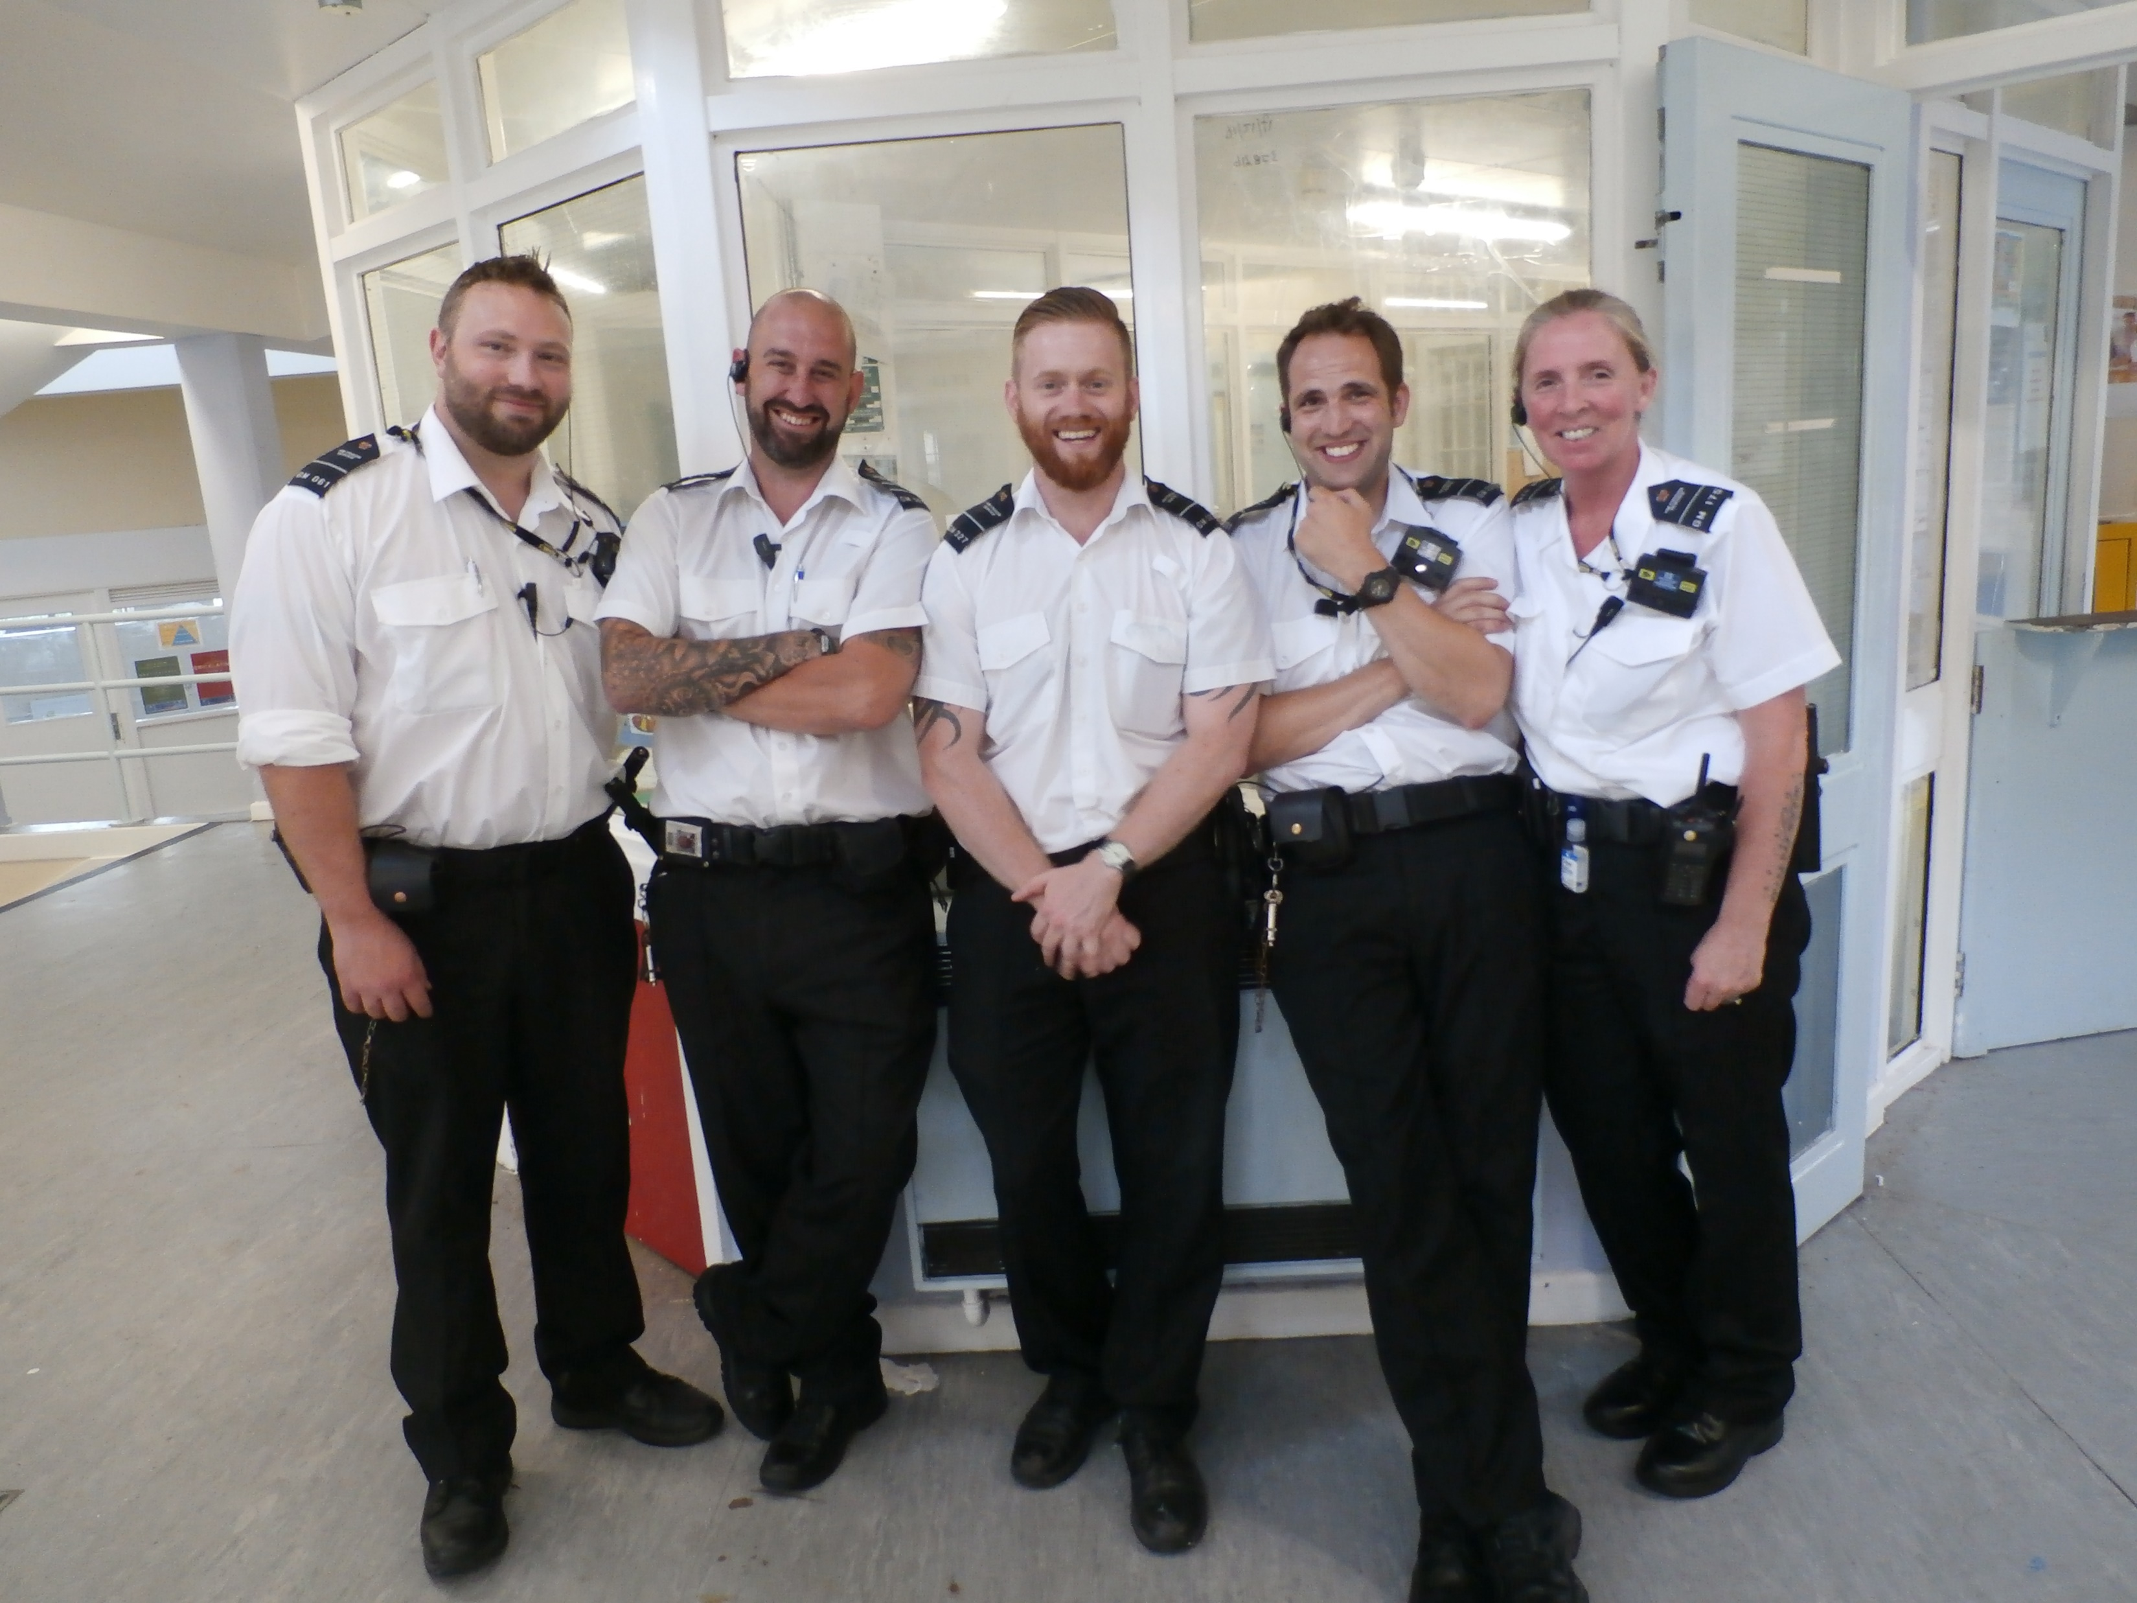
Relationships Matter

Slide 33
Probation practice, emotional labour, wellbeing and the pandemic
Dr Jake Phillips
Reader in Criminology
Helena Kennedy Centre for International Justice
Sheffield Hallam University
Jake.Phillips@shu.ac.uk

Slide 34
What is Emotional Labour?
'The management of a way of feeling to create a publicly observable facial and bodily display…for a wage.' (Hochschild, 1983, 7fn)
Surface acting
Deep acting
Display rules

Slide 35
Links to wellbeing
Emotional labour linked to risk of burnout;
High levels of surface acting more strongly correlated with burnout;
Range of formal and informal coping strategies.

Slide 36
Probation work in the pandemic
Exceptional Delivery Model
Unpaid work and group programmes cancelled;
Most supervisions conducted over the phone/video-call;
Some high-risk supervisees seen through ‘doorstep’ visits or ‘social distanced walks’.

Slide 37
Implications for emotional labour
Will change the nature of the emotional labour performed and the emotional demands of the work;
Surface/deep acting over phone/video-call different to in person.

Slide 38
Implications for work-family conflict
Strategies to ‘leave work at work’ no longer possible
‘Some [staff] are having to work, complete interventions and interviews with sex offenders in their bedrooms as it’s the only quiet space.’
Coping with abuse
‘Not prepared to have that person look into my house.’
Confidentiality
‘Sex offenders over-hearing their children in the background has been hard for them and the service user.’

Slide 39
Implications for obtaining support
Informal supports gone
Less experienced staff

Slide 40
Coping strategies
Online reflective spaces during lockdown
Office for certain video-calls/hearing
Access to counselling
Coffee mornings and quizzes
Keeping Skype call open
Mutual 'workspace’

Slide 41
Some positives
Flexibility and improved work life balance
Teams are pulling together
Better relationships
Socially distanced walks – ‘felt like a probation officer again’.
Work feels more meaningful

Slide 42
Looking ahead
The pandemic makes visible the structures and support that are normally invisible
Continued working from home may require more support for staff
Focus on less experienced staff and those working with service users who are most likely to cause distress
Take on some of the positives

Slide 43

Questions for the Panelists

Slide 44

Out of all the ideas presented today, what is one thing you will implement to support your own well-being? Type it in the chat box.

Slide 45
We appreciate you joining us for this webinar. We hope that it has been helpful to you and your colleagues.
We appreciate you joining us for this webinar!
Panelists:
rtimme@falconinc.com
Gabriel_ONG@pris.gov.sg
info@penalreformsolutions.com
Jake.phillips@shu.ac.uk
Facilitators:
fporporino@rogers.com
executivedirectoriacfp@gmail.com
Websites:
www.myiacfp.org
www.icpa.org

